Slide 1
User Research Study 3 Homepage Wireframes
Prepared by the Digital Service at Veterans Affairs (DSVA)
Prepared for and presented to the VA Web Brand Consolidation Working Group
April 2018

Slide 2
Outline
This study helped us to understand how Veterans think information on the va.gov homepage should be organized.
1. Study Objectives
2. Research Method
3. Findings
4. Recommendations

Slide 3
1. Study Objectives

Slide 4
Our goal was to gather feedback on two homepage designs
Study objectives
Which of our wireframe concepts works best for Veterans?
What are the pros/cons of each?
How do Veterans prioritize the benefit categories?
What do Veterans think of the top task approach?
What do Veterans think of the lifecycle approach?

Slide 5
2. Research Method

Slide 6
We spoke with Veterans in person to learn more about what works for them.
Research Method
Visited DC Medical Center – Women’s Clinic
Spoke with 10 women Veterans of varying ages and races
Showed them two options for a new homepage (paper wireframes)
Asked structured questions to gather feedback

Slide 7
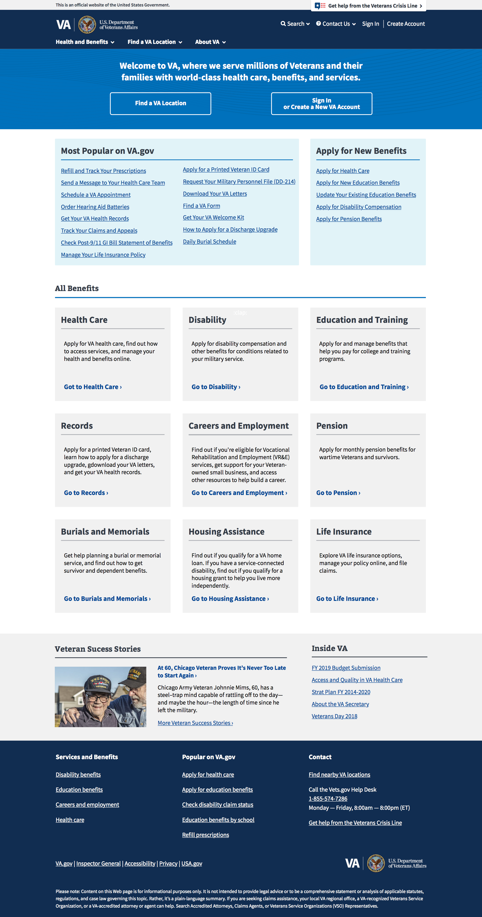
Research Method
Header
Zone 1 – Welcome, location, login
Zone 2 – Top tasks or benefits
Zone 3 – All benefits
Zone 4 – Good news stories, inside VA
Footer

Slide 8
Research Method
Header
Zone 1 – Welcome, location, login
Zone 2 – Top tasks or benefits
Zone 3 – All benefits
Zone 4 – Good news stories, inside VA
Footer

Slide 9
Top Tasks Homepage
Research Method
Zone 2 focused on the top tasks available to Veterans split between recurring “manage” and one time “apply” boxes
Zone 3 listed each benefit category with a simple description and CTA

Slide 10
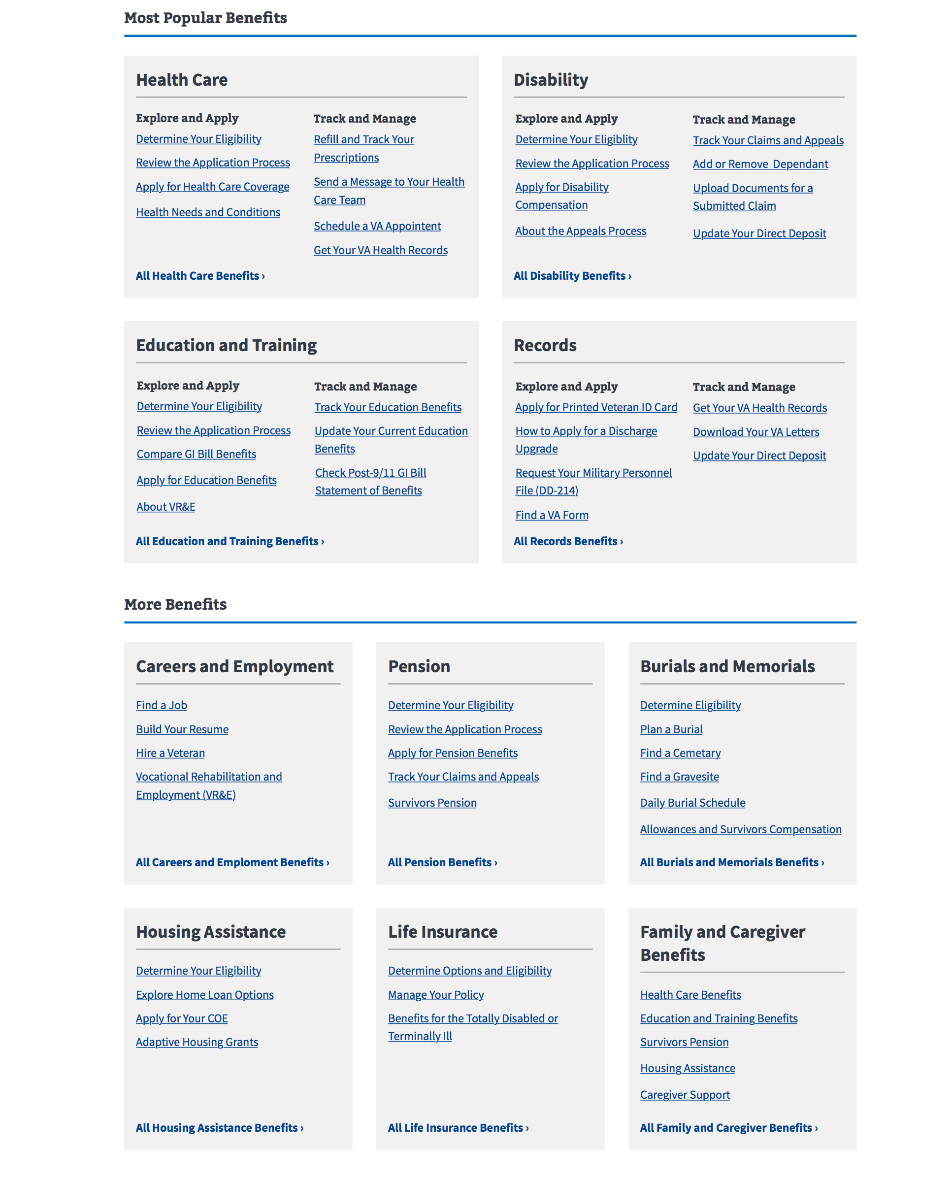
Benefit Category Homepage
Research method
Zone 2 listed the top 4 benefit categories with top tasks listed under “Explore & Apply” or “Track & Manage”
Zone 3 showed the remaining benefits with lists of top tasks for each

Slide 11
3. Findings

Slide 12
We learned that Veterans want the context of the benefit category but also quick links
Findings
7/10 preferred “Benefit Category” design over “Top Tasks”
Benefit hubs were confirmed as a good organization method
Veterans wanted the most popular list in each benefit but were overwhelmed by the number of choices
Separating top tasks from benefit labels was “distracting”
Both designs were “clean” but “boring” and needed more images
Appreciation for the one-click access to top resources

Slide 13
In their own words…
Findings
“The other one [Top Tasks] is more visually pleasing, but this one [Benefit Categories] seems like it packs more information and links in.” – P5
“I like that the three things I said I would go on here for are at the top.”
– P8
“It looks pretty user-friendly. You’ve got it categorized pretty well.” – P7
"The headings make it easy to find information” – P4
“Images would be good, it looks boring.” – P2
“I mean I like it – don’t get me wrong – but I think it has too much. My eyes go all over.” – P6

Slide 14
Additional things we learned
Findings
Personalization and customization are important
“Records” worked well as a category
Generic sub-headings were less useful - “All Benefits”
Desire for more contact and support options
Success stories / news was well received but not the photo

Slide 15
Some feedback about the current state of Va.gov
Findings
“I don’t think it works well on our phones – the websites.” – P9
"Half the time I have to go to Google to find the right VA.gov page” - P8
"Other VA websites are not very user friendly” – P7
“If you don’t live in this area, a lot of people don’t know about all these benefits and services” – P2

Slide 16
Themes - Benefit Category
findings
Benefit categories are a good starting point and tiles work well
Too much info
Top task list in each benefit works well
Good clean design
Boring design (wireframes)
Records worked as a category
Generic sub-headings and terminology were less useful
Wanted more help/contact info
Missing personalization and customization
Non-VA resources desired (like state benefits)

Slide 17
Themes - Top Tasks
findings
Success stories worked well, but not photo
Descriptions worked well for users that prefer to read
Clean design
Benefit category model worked
Looking for contact info
More images desired
Design was “distracting” high cognitive load of splitting top tasks from benefit categories
Simple design but boring
One-click access is good

Slide 18
4. Recommendations

Slide 19
What Now?
Recommendations
We are updating our designs to incorporate the user feedback. These designs will go to our next round of user testing.

Slide 20
We plan to make these changes based on user feedback.
Recommendations
Top Tasks design
Reduced tasks from 22 to 16
Chunked tasks together for scanning
Benefit Category
Reduced the number of links: 5-6 for the larger benefit categories, 3 links for the smaller benefit categories
Refined the links for each benefit category to be top tasks
Removed the benefit lifecycle sub-headings

Slide 21
We plan to make these changes based on user feedback.
Recommendations
Both designs
Increased the fidelity of both designs to increase visual interest through icons and images
Added crisis line and Help link
Continued to use “view all” buttons/links
Added faces of veterans to the bottom of both designs

Slide 22
Thank you!
Contact Jeff Barnes with questions:
jeffrey.barnes4@va.gov

Slide 23
Limitations of Study
Appendix
All participants were women
All participants were currently enrolled in VA Medical care, but not necessarily MHV users
Participants were limited to one medical center in DC area
Paper wireframe format varies significantly from interactive, especially related to navigation priority and fold placement

Slide 24
Did we answer our research questions?
Appendix
Which of our wireframe concepts works best for Veterans? Benefit Category
What are the pros/cons of each? Listed above
How do Veterans prioritize the benefit categories? Confirmed that Health, Disability, Education, and Records are primary
What do Veterans think of the top task approach? Listed above
What do Veterans think of the lifecycle approach? They were ambivalent on the lifecycle labels but the term “Apply” caught their eye, more testing needed.

